Slide 1
6CS003 – Graphics and Artificial Intelligence
Week 3
Bezier Curves

Slide 2
Overview
What is a Bezier Curve
Types of Curve
Task 3

Slide 3
What is a Bezier Curve
Well lets take a step back and look at some curves….

Slide 4
What is a Bezier Curve
A Bezier curve allows a series of points to be represented as a curve
So a series of lines (or path) now a more gradual curve
https://pomax.github.io/bezierinfo/
Notes:
Published by Pierre Bezier (Renault) 1962
Paul de CastelJau (Citroes) 1959

Slide 5
Why Are They Used
They can reduce processing as the underlying maths is compact and easy to understand.
They allow any set of points to be represented as a more natural curve, so could be used in applications like games or art packages as can be seen next.
Can store less points and calculate the curved transform on the fly, saving processing and storage.

Slide 6
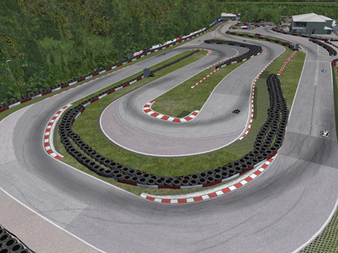
Bezier Curves Games
Allows a more natural curve path around navigation points
x
x
x
x
x
x
x
x
http://www.tracktalent.co.uk/category/sim-racing/

Slide 7
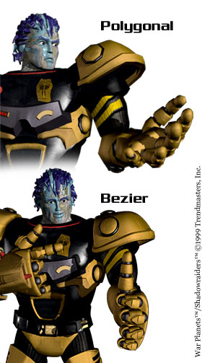
Bezier Curves Games
Bezier curves used to show more rounded arms
http://uk.ign.com/articles/1999/02/19/is-the-playstation-2-cg-quality

Slide 8

Bezier Curves Art
http://muddycolors.blogspot.co.uk/2012/12/about-curves-and-lines.html

Slide 9

Bezier Curves for Fonts
http://research.microsoft.com/en-us/projects/gpu_rendering_curves_and_surfaces/default.aspx

Slide 10
The Theory
2 points – Linear curve
3 points – Quadratic curve
4 points – Cubic curves
x
P₁
x
P₂
P₁
x
x
P₁
x
x
P₂
P₀
x
x
P₀
x
P₀
P₃

Slide 11
Linear Curve (2 points)
[x,y] = (1-t)P₀ + tP₁
(t range 0 to 1) (0 start point of curve)(1 end point of curve)
x
P₁
x
P₀

Slide 12
Quadratic Curve (3 points)
[x,y] = (1-t)²P₀ + 2(1-t)tP₁+t²P₂
(t range 0 to 1) (0 start point of curve)(1 end point of curve)
x
P₁
x
P₁
x
x
P₂
P₂
x
x
P₀
P₀

Slide 13
Cubic Curve (4 points)
[x,y] = (1-t)³P₀ + 3(1-t)²tP₁+3(1-t)t²P₂+t³P₃
(t range 0 to 1) (0 start point of curve)(1 end point of curve)
x
P₁
x
P₁
x
P₂
P₂
x
x
x
P₀
P₀
x
P₃
x
P₃

Slide 14
Self Study
Read up on complex paths 5+
Web Resources
http://devmag.org.za/2011/04/05/bzier-curves-a-tutorial/
http://www.html5canvastutorials.com/tutorials/html5-canvas-bezier-curves/
http://en.wikipedia.org/wiki/B%C3%A9zier_curve

Slide 15
ASSIGNMENT 1: GRAPHICS
TASK 3 – BEZIER CURVES

Slide 16
In the Workshop
Download from Wolf and save: -
  Task 3.zip
  It contains a HTML file, CSS file and 2 java script files.
  Run the application by running index.html
  Each week you will need to modify the jsToBeUpdated.js file found in the relevant task.
  Once you are happy with your code you need to validate it in JSLint (www.jslint.com). This checks your Java Script for conformance.

Slide 17
Task 3 – Bezier Curve
Here is the function which needs code:
    drawBezierCurve()
Hints
  1/number of steps (as t ranges from 0 to 1)
  Iterate through until complete
  Calculate new X and Y points
  Obviously fewer steps, less lines and they are longer.

Slide 18
EXPECTED RESULTS

Slide 19
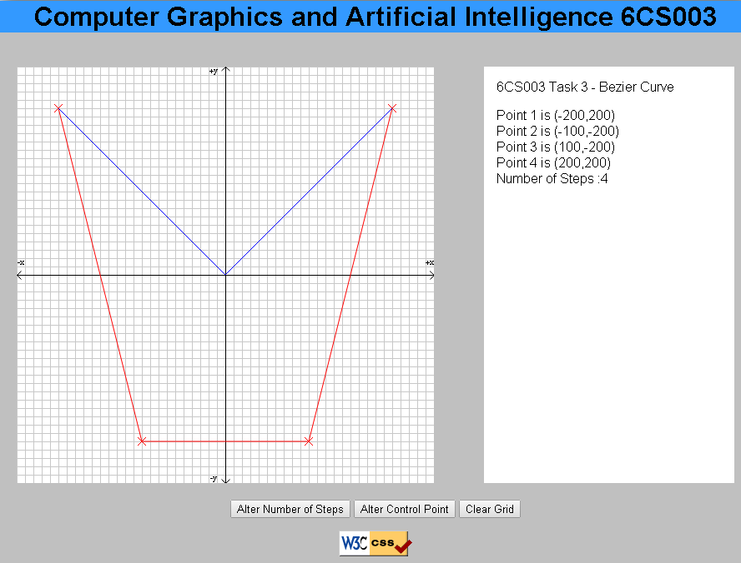
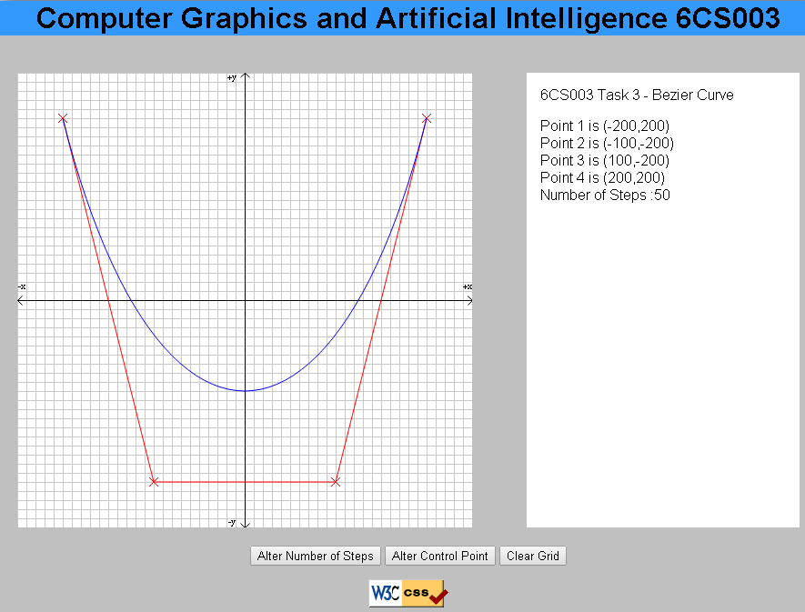
Bezier Curve
Before function is re-written Desired result

